Slide 1
Data Center Infrastructure CT109-3-2&Version 2
Data Center Cooling Systems

Slide 2
Topic & Structure of The Discussion
Hot Aisle Containment System
Cold Aisle Containment System

Slide 3
Learning Outcomes
At the end of this topic, YOU should be able to:
Understand Data Center Cooling Systems

Slide 4
Key Terms You Must Be Able To Use
If you have mastered this topic, you should be able to use the following terms correctly in your assignments and exams:
Hot Aisle
Cold Aisle

Slide 5
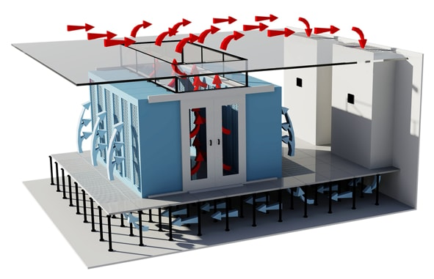
Hot Aisle Containment System
Hot Aisle Containment System
A hot aisle containment system (HAC) uses a physical barrier to guide hot exhaust towards the AC return. This system has the advantage of the natural properties that cause warm air to rise. The hot air is directed upward into an AC return like a drop-ceiling void.

Slide 6
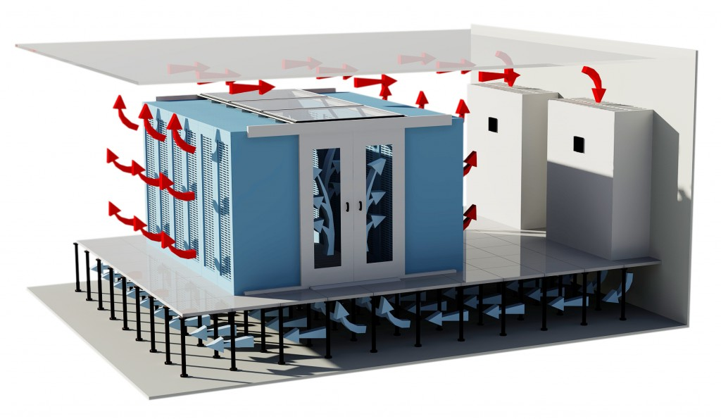
Cold Aisle Containment System
Cold Aisle Containment System
A cold aisle containment system (CAC) in a data center has doors at the end of the aisles and partitions on the ceiling that act as a physical barrier to contain the supply airflow. The doors are necessary to prevent the air from leaking out of the aisle ends.

Slide 7
Benefits of Containment System
Using containment, the data center makes cooling efficient
A robust containment solution can reduce energy consumption up to 25-percent and deliver 20-percent energy savings
80% of all data centers have implemented or are looking to install cold or hot aisle containment options

Slide 8
Quick Review Question
1.Briefly explain the following:
i. Hot Aisle Containment System
ii. Cold Aisle Containment System

Slide 9
Summary of Main Teaching Points
Discussed Data Center Cooling Systems

Slide 10
Question and Answer Session
Q & A

Slide 11
What we will cover next
Fire Suppression System

